Slide 1

Balance Functions of Identified Hadrons in Au+Au Collisions at 200 GeV
Nandita Raha
Postdoc Fellow, Wayne State University
12/12/2022
Seminar – University of Illinois, Chicago

Slide 2
Outline
Introduction to heavy – ion collisions and the STAR Experiment
Motivation and Goal
Analysis Details
Two – particle Correlation Function
Balance Function
Comparison of Data and Model
Summary and Conclusions

Slide 3
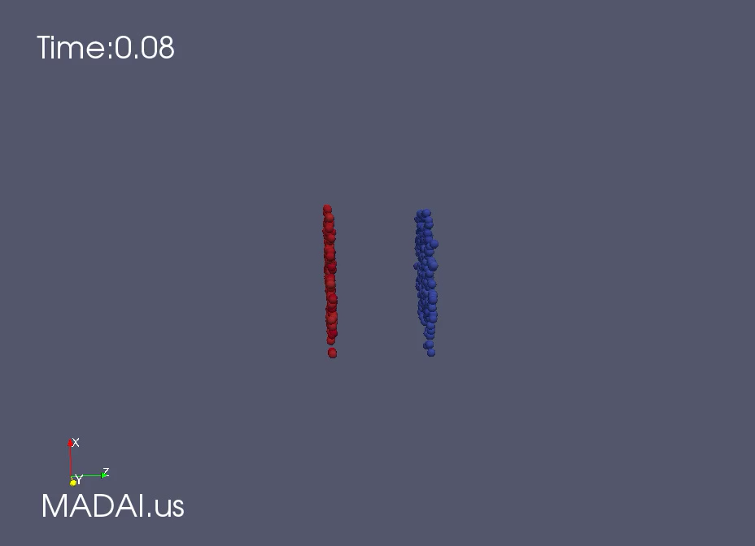
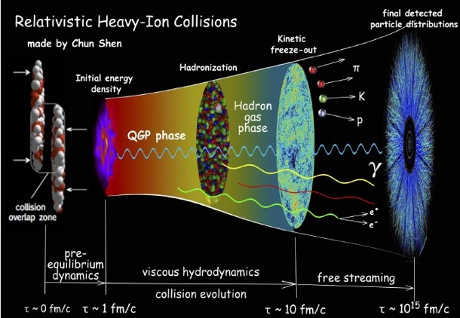
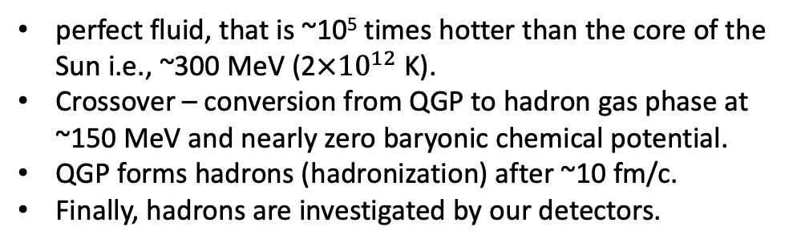
Introduction to Heavy – Ion Collisions
Heavy ions colliding at ultra–relativistic energies instantly produces deconfined Quark-Gluon Plasma (QGP):
perfect fluid, that is ~10⁵ times hotter than the core of the Sun i.e., ~300 MeV ($\text{2}×{10}^{12} \text{K}$).
Crossover – conversion from QGP to hadron gas phase at ~150 MeV and nearly zero baryonic chemical potential.
QGP forms hadrons (hadronization) after ~10 fm/c.
Finally, hadrons are investigated by our detectors.
_
+
Measuring correlations of the particle directions
shows charges move away from each other;
i.e., how they "diffuse."
3

Slide 4
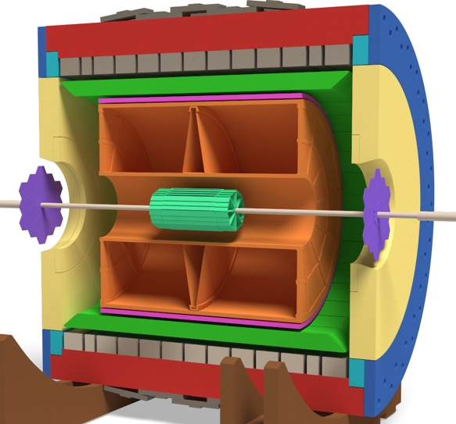
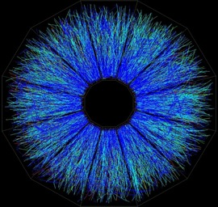
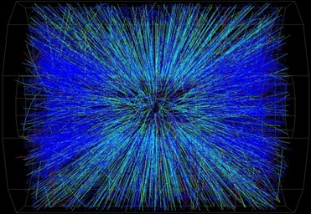
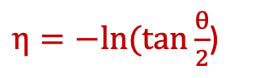
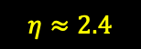
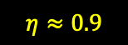

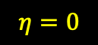
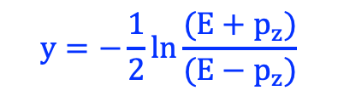
Star Experiment
Collisions measured by the STAR detector:
- Time Projection Chamber (TPC).
BEMC
- Time of flight (ToF).
ToF
TPC
TPC measures - momentum of “all” charged tracks in a defined acceptance.
Tracks in TPC are described by:
BBC
azimuthal angle, φ–transverse
HFT
θ = 90º
$$η=0$$
θ = 45º
$$η≈0.9$$
Polar angle θ, along
the beam direction (Z-axis).
φ
θ = 10º
$$η≈2.4$$
We use (pseudo)rapidity instead of θ
θ = 0º
$$y=−\frac{1}{2}ln⁡\frac{(E+p_{z})}{(E−p_{z})}$$
$η=−ln⁡(tan\frac{θ}{2}$)
$\vec{B}$ into page
4

Slide 5
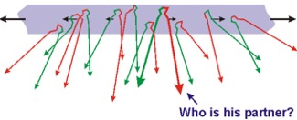
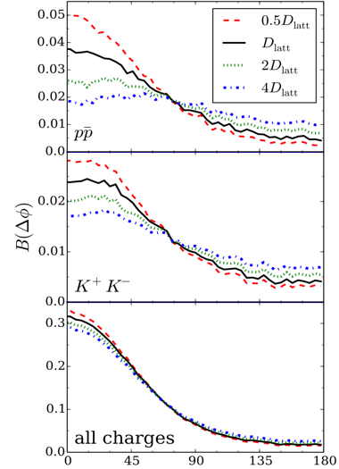
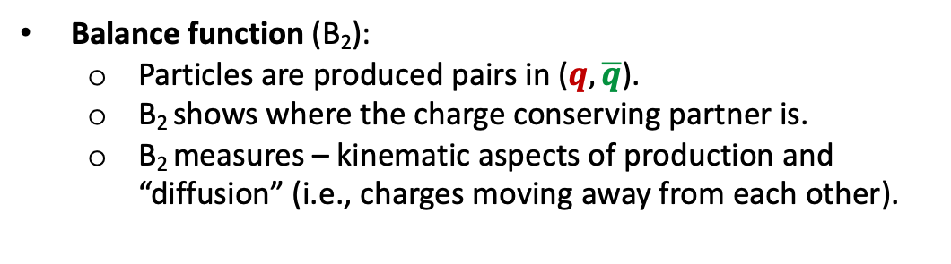
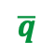
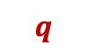
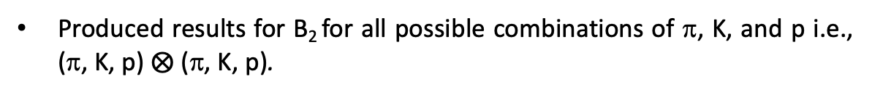
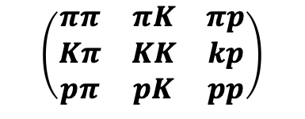
Motivation and Goal
Au+Au , 200 GeV, 0-5% centrality
Balance function (B₂):
Particles are produced pairs in ($q, \overline{q}$).
B₂ shows where the charge conserving partner is.
B₂ measures – kinematic aspects of production and “diffusion” (i.e., charges moving away from each other).
$$\overline{q}$$
$$q$$
S. Pratt and C. Plumberg’s Model – diffusion increases when the distribution widens i.e., ∆φ increases. Plot shows – balancing charges are moving farther away from each other due to diffusion which changes the shape of B₂.
more
“diffusion”
Compare B₂ from data and for events generated from four commonly used models –
UrQMD, HIJING, and SMASH – hadronic cascade models.
AMPT – hadronic collisions along with quark phase transitions.
Particles
Particles
Produced results for B₂ for all possible combinations of π, K, and p i.e., (π, K, p) $⨂$ (π, K, p).
closer
far apart
$$\left(\begin{matrix}ππ & πK & πp \\ Kπ & KK & kp \\ pπ & pK & pp\end{matrix}\right)$$
S. Pratt and C. Plumberg
PRC 102, 044909 (2020)
Notes:
Balance functions can be used to study:
Delayed hadronization
Time scales of charge production
Diffusion and other details of .
Could help find a potential critical point if studied against energy (sudden decrease in correlation at CP)

Slide 6
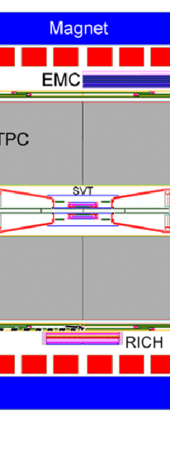


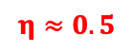
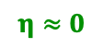
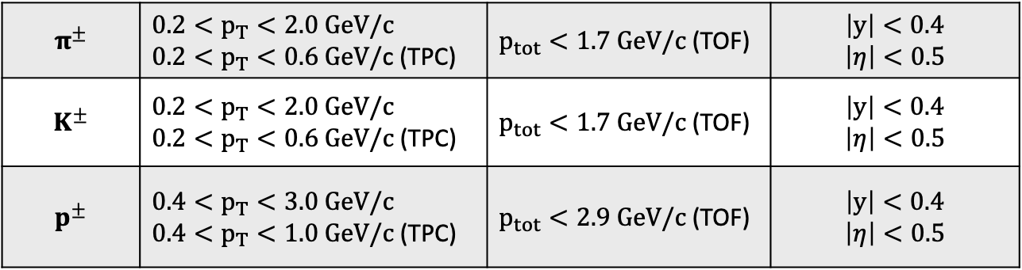
Analysis details
Event Selection:
Longitudinal distance along beam axis: |V_{z}|< 30cm.
Radial or transverse distance perpendicular to beam axis: |V_{r}|< 2 cm respect to the nominal beam position.
$$η≈0$$
$$η≈0.5$$
$$η≈1$$
|V_{z}|= 30 cm
Analysis
Track Selection:
Global distance of closest approach of <2 cm.
No. of hit points fitted to form tracks in the TPC is $≥$ 18.
Window
$$π^{±}$$ | $$0.2<p_{T}<2.0 GeV/c$$ $0.2<p_{T}<0.6 GeV/$c (TPC) | $p_{tot}<1.7 GeV/c$ (TOF) | $$\left|y\right|<0.4$$ $$\left|η\right|<0.5$$
$$K^{±}$$ | $$0.2<p_{T}<2.0 GeV/c$$ $0.2<p_{T}<0.6 GeV/c$ (TPC) | $p_{tot}<1.7 GeV/c$ (TOF) | $$\left|y\right|<0.4$$ $$\left|η\right|<0.5$$
$$p^{±}$$ | $$0.4<p_{T}<3.0 GeV/c$$ $0.4<p_{T}<1.0 GeV/c$ (TPC) | $p_{tot}<2.9 GeV/c$ (TOF) | $$\left|y\right|<0.4$$ $$\left|η\right|<0.5$$
Correlation functions are measured inside this acceptance box.
Notes:
centrality is defined using refmult2, which is the count of all primary tracks with 0.5 < abs(eta) < 1.0 and analysis is performed for abs(eta)<0.5

Slide 7
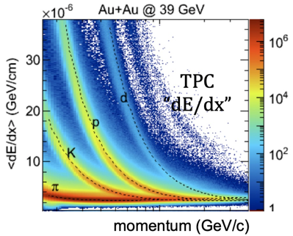
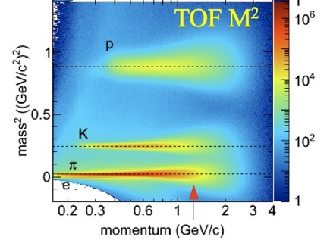

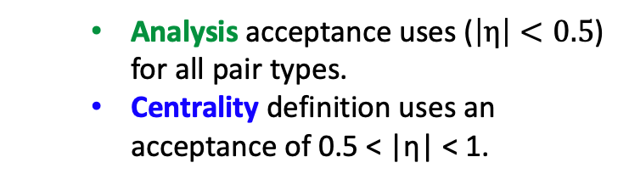
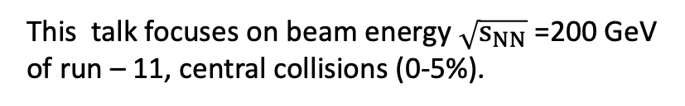
Analysis details – Data Sets
Detectors used for particle identification:
Time Projection Chamber (TPC).
Time of flight detector (ToF).
BES-I Dataset – Au+Au
Beam Energy (GeV) | No. of Events (Million)
7.7 | 4
11.5 | 12
14.5 | 20
19.6 | 36
27 | 70
39 | 130
62.4 | 67
200 | 45
Analysis acceptance uses ($\left|η\right|<0.5$) for all pair types.
Centrality definition uses an acceptance of 0.5 < |η| < 1.
N_{primary}
-1
-0.5
0
0.5
1
Entire BES-I dataset analyzed.
Centrality
Centrality
Analysis
Central
Peripheral
This talk focuses on beam energy $\sqrt{s_{NN}}$=200 GeV of run – 11, central collisions (0-5%).
Notes:
Centrality def. Fitted using Bichsel for energy loss or stopping pot. dE/dx loss (pronounced as Bixel) -

Slide 8
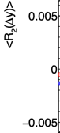
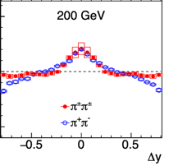
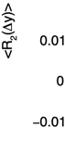
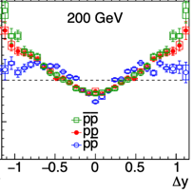
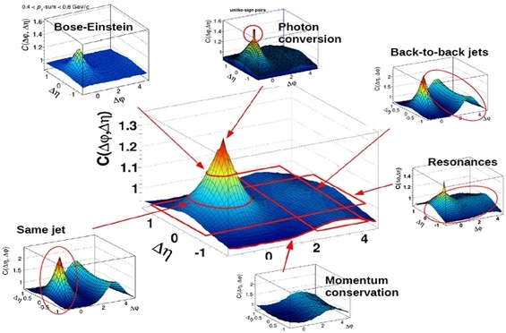
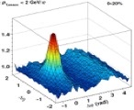
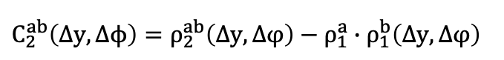
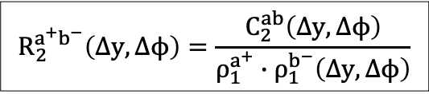
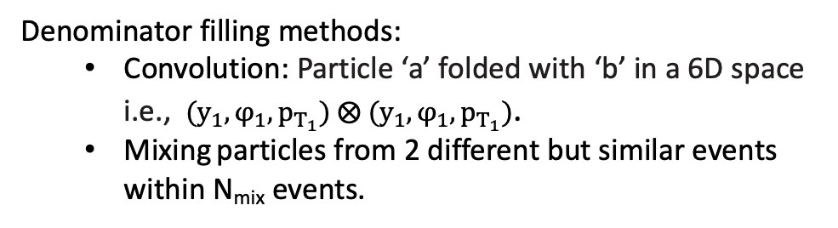
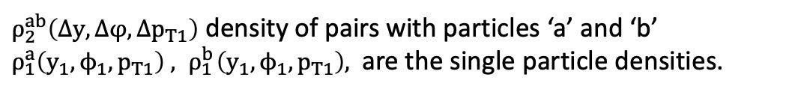
Two – particle Correlation Function ($R_{2}$)
2-Particle Cumulant or Correlator:
$ρ_{2}^{ab}\left(Δy, Δφ,Δp_{T1}\right)$ density of pairs with particles ‘a’ and ‘b’
$ρ_{1}^{a}\left(y_{1},ϕ_{1},p_{T1}\right) , { ρ}_{1}^{b}\left(y_{1},ϕ_{1},p_{T1}\right),$ are the single particle densities.
$$C_{2}^{ab}\left(Δy, Δϕ\right)=ρ_{2}^{ab}\left(Δy, Δφ\right)−ρ_{1}^{a}∙ρ_{1}^{b}\left(Δy, Δφ\right)$$
$$R_{2}^{a^{+}b^{−}}\left(Δy, Δϕ\right)=\frac{C_{2}^{ab}\left(Δy, Δϕ\right)}{ρ_{1}^{a^{+}}∙ρ_{1}^{b^{−}}\left(Δy, Δϕ\right)}$$
STAR, Phys. Rev. C 101, 014916 (2020)
M. Janik, International conference on New Frontiers in Physics, 2015
R₂ - Corrected for pair-inefficiency called ‘crossing’.
Densities corrected for inefficiencies.
Efficiencies obtained from embedded data.
Denominator filling methods:
Convolution: Particle ‘a’ folded with ‘b’ in a 6D space i.e., ${ (y}_{1},φ_{1},p_{T_{1}}) ⨂{ (y}_{1},φ_{1},p_{T_{1}})$.
Mixing particles from 2 different but similar events within N_{mix} events.
The anisotropic
elliptic flow
Mixing approximates convolution as N_{mix} increases.
Notes:
C2 is the excess pair density compared to reference single particle densities. R2=Correlator/reference density.

Slide 9
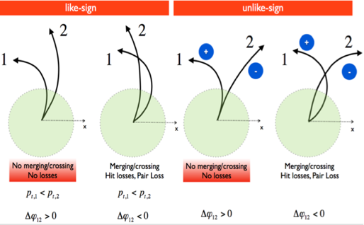
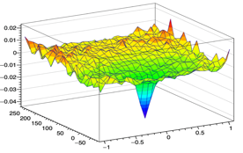
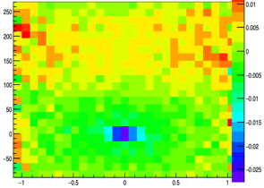
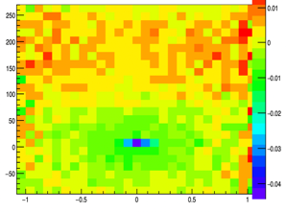
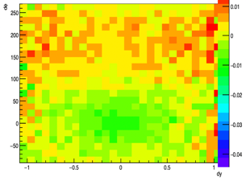
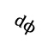



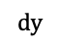
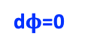
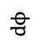
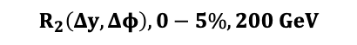
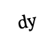

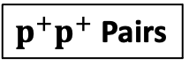
Track crossing correction
Pairs with overlapping tracks (crossing/merging) are too close for the TPC to resolve them.
1
1
1
1
2
2
2
2
Results in a pair-inefficiency for these particles, causing a crossing "hole" for (dy, d$ϕ$) ~0.
$${p^{+}p^{+} R}_{2}\left(Δy, Δφ\right), 0−5\%, 200 GeV$$
p_{T1}> p_{T2}
p_{T1}> p_{T2}
$$dϕ$$
dφ₁₂ < 0
dφ₁₂ > 0
dφ₁₂ < 0
dφ₁₂ > 0
Azimuthal direction
$$dy$$
Beam direction
Image Courtesy P. Pujahari
pt-ordered each pair to move the hole on one side of d$ϕ$=0.
Reflected clean bins as distributions are symmetric about (dy,dφ)=0.
Technique from (Tarini thesis – 01/2011, WSU)
Finally, symmetrized about (dy,dφ)=0 to undo pt-ordering.
$$R_{2}\left(Δy, Δφ\right), 0−5\%, 200 GeV$$
$$R_{2}\left(Δy, Δφ\right), 0−5\%, 200 GeV$$
$$R_{2}\left(Δy, Δφ\right), 0−5\%, 200 GeV$$
$$dϕ$$
$p^{+}p^{+}$ Pairs
Pt-ordered
Reflected Bins
d$φ$=0
$$dy$$
Notes:
centrality is defined using refmult2, which is the count of all primary tracks with 0.5 < abs(eta) < 1.0
and analysis is performed for abs(eta)<0,5

Slide 10
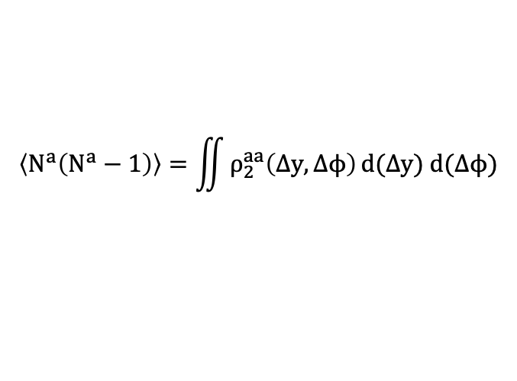
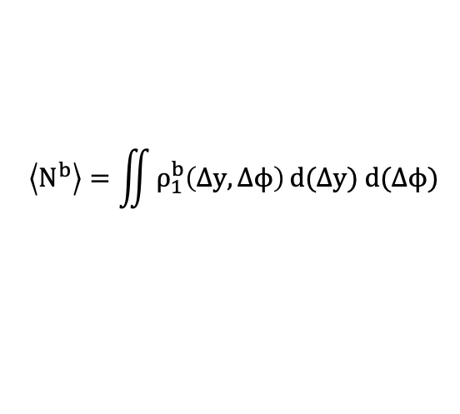






Balance Function ($B_{2}$)
$$B_{2}\left(Δy, Δφ\right), 0−5\%, 200 GeV$$
Balance Function (B₂)
Balance function B₂ is a multiplicity–weighted two–particle correlation functions.
BF of positive charged particle 1 (a⁺) :
$$B_{2}^{a^{+}b}\left(∆y, ∆φ\right)= \frac{ρ_{2}^{a^{+}b^{−}}\left(∆y, ∆ϕ\right)}{ρ_{1}^{a^{+}}\left(∆y, ∆ϕ\right)} − \frac{ρ_{2}^{a^{+}b^{+}}\left(∆y, ∆ϕ\right)}{ρ_{1}^{a^{+}}\left(∆y, ∆ϕ\right)}$$
$$B_{2}^{a^{+}b}\left(∆y, ∆φ\right)=N^{b^{−}}R_{2}^{a^{+}b^{−}}\left(∆y, ∆ϕ\right) − N^{b^{+}}R_{2}^{a^{+}b^{+}}\left(∆y, ∆ϕ\right)$$
Constants (or prefactors) $N^{b^{−}}$and $N^{b^{+}}$ are efficiency-corrected integrals of ${ ρ}_{1}^{b−}$ and ${ ρ}_{1}^{b+}$ respectively.
Factorial moment of multiplicity distribution of ‘b’
BF of negative charged particle 1 (a⁻):
$$\left\langle N^{b}\right\rangle =\iint{ρ_{1}^{b}\left(Δy,Δϕ\right)}d(Δy) d(Δϕ)$$
Single particle density:
${ B}_{2}^{a^{−}b}\left(∆y, ∆φ\right)= N^{b^{+}}R_{2}^{a^{−}b^{+}}\left(∆y, ∆ϕ\right) −$ $N^{b^{−}}R_{2}^{a^{−}b^{−}}\left(∆y, ∆ϕ\right)$
Particle pair density –
$$\left\langle N^{a}\left(N^{a}−1\right)\right\rangle =\iint{ρ_{2}^{aa}\left(Δy, Δϕ\right)}d(Δy) d(Δϕ)$$
Charged Balance Function (B₂):
Indistinguishable:
$$B_{2}=\frac{B_{2}^{a^{+}b}\left(∆y, ∆φ\right)+B_{2}^{a^{−}b}\left(∆y, ∆φ\right)}{2}$$
Distinguishable:
$$\left\langle N^{a}N^{b}\right\rangle =\iint{ρ_{2}^{ab}\left(Δy, Δϕ\right)}d(Δy) d(Δϕ)$$
Two types of pair cuts are applied here:
M_{inv}: rejects pairs from φ, K_{S}, and Λ (and antiparticle) decays using cuts on pair invariant mass ($±$10 MeV).
Q cut: rejects pairs with values of the Lorentz-invariant-relative momentum (Q) < 150 MeV. Removes all femtoscopic correlations. STAR, Phys. Rev. C 101, 014916 (2020).
Notes:
Femtoscopy ref. paper. M.A. Lisa, S. Pratt, R. Soltz, and U. Wiedemann. Ann. Rev. Nucl. Part. Sci., 55:357– 402, 2005
Femtoscopy: It is the interference of (identical) particles which have very small relative momentum and very close to each other (dy,dphi~0). Such particles are highly correlated causing a peak in R2.

Slide 11



ε(p_{Τ}) for a rapidity slice for π
Efficiency correction from embedded maps
$$f_{ε}\left(p_{T}\right)=a_{0}+a_{1}e^{a_{2}p_{T}}+\frac{a_{3}}{p_{T}}$$
Inefficiencies are corrected using efficiency maps as functions of (y, pt) determined by "embedding”. These are for every centrality, particle species, charge, and beam energy.
Fitted values (fit function shown) are used to smooth out the statistical fluctuations.
p_{T} (MeV/c²)
Integral of Balance Functions
The integral of these $B_{2}$ represents the conditional probability of a particle species that is charge balanced with any other particle π, K, and p.
$$B_{2}\left(Δy, Δφ\right), 0−5\%, 200 GeV$$
$$I=\iint{B_{2}\left(dy,dφ\right) d(Δy)d(Δφ)}$$

Slide 12






R₂ for $ππ$ at 0-5% centrality
Explore the effects of the Minv and/or Q cuts on the correlation functions.
$$π^{+}π^{+}$$
$$π^{−}π^{−}$$
$$π^{+}π^{−}$$
$$π^{−}π^{+}$$
$\text{Au}\text{+}\text{Au}\text{ 200 }\text{GeV}$
$0.2<p_{T}<2.0, \left|y\right|<0.4$
Efficiency Corr.
Efficiency Corr. M_{inv}
Efficiency Corr.M_{inv} Q cut
$\text{Au}\text{+}\text{Au}\text{ 200 }\text{GeV}$
$0.2<p_{T}<2.0, \left|y\right|<0.4$
Pion correlations show a peak at $\left(Δy, Δφ\right)\sim 0$ in both LS and US charge combinations due to femtoscopic correlations.
Notes:
R2_data_comp.C to get these plots. TPC acceptance: In dphi is 2pi and in pseudorapidity is |eta| = 1.8 or +/-1.8….Ref Nucl.Instrum.Meth.A 499 (2003) 624-632
Results fixed!!

Slide 13


















B₂ from R₂ for $ππ$ 0-5% centrality
We calculate differential B₂(Δy,Δφ) using prefactors and R₂(Δy,Δφ).
$a,b→$ π, π
${ B}_{2}^{π^{+}π}\left(∆y, ∆φ\right)= N^{π^{−}}R_{2}^{π^{+}π^{−}}\left(∆y, ∆φ\right) −$ $N^{π^{+}}R_{2}^{π^{+}π^{+}}\left(∆y, ∆φ\right)$
$$\text{Au}\text{+}\text{Au}\text{ 200 }\text{GeV}$$
$$B_{2+}$$
$$B_{2+}^{π^{+}π}(Δy,dφ)$$
$$R_{2}^{π^{+}π^{−}}(Δy,dφ)$$
$$R_{2}^{π^{+}π^{+}}(Δy,Δφ)$$
${ B}_{2}^{π^{−}π}\left(∆y, ∆φ\right)= N^{π^{+}}R_{2}^{π^{−}π^{+}}\left(∆y, ∆φ\right) −$ $N^{π^{−}}R_{2}^{π^{−}π^{−}}\left(∆y, ∆φ\right)$
$$B_{2−}$$
$$B_{2}=\frac{B_{2+}+B_{2−}}{2}$$
$$B_{2+}^{π^{−}π}(Δy,Δφ)$$
$$R_{2}^{π^{−}π^{+}}(Δy,Δφ)$$
$$R_{2}^{π^{−}π^{−}}(Δy,Δφ)$$
Notes:
TPC acceptance: In dphi is 2pi and in pseudorapidity is |eta| = 1.8 or +/-1.8….Ref Nucl.Instrum.Meth.A 499 (2003) 624-632
Results fixed!!

Slide 14







B₂ for $ππ$ at 0-5% centrality
The ridge near $\left(Δy, Δφ\right)\sim 0$ means the charge conserving partner is nearby.
The observed local decrease of B₂ at $\left(Δy, Δφ\right)\sim 0$ is due to femtoscopic correlations.
$$B_{2}^{π^{+}π}\left(∆y, ∆φ\right)=N^{π^{−}}R_{2}^{π^{+}π^{−}}\left(∆y, ∆ϕ\right) − N^{π^{+}}R_{2}^{π^{+}π^{+}}\left(∆y, ∆ϕ\right)$$
$N^{π^{−}},N^{π^{+}}$ are comparable.
Efficiency Corr.M_{inv} Q cut
Efficiency Corr. M_{inv}
Efficiency Corr.
$\text{Au}\text{+}\text{Au}\text{ 200 }\text{GeV}$
$0.2<p_{T}<2.0, \left|y\right|<0.4$
$R_{2}^{π^{+}π^{−}}\left(0, 0\right) \text{<} R_{2}^{π^{+}π^{+}}\left(0, 0\right)$ resulting in a dip in B₂₊
$$0.2<p_{T}<2.0$$
$\left|y\right|<0.4$
S. Pratt and C. Plumberg’s Model
more
“diffusion”
Notes:
Macro used B2_data_comp.C. Multiplicities are with weights obtained from integral of hyc1 etc. and different hmult. Results fixed!!

Slide 15
B₂(Δy, Δφ) at 0-5% for all species at 200 GeV
All hadron species showing differential B₂(Δy,Δφ) in the same scale. Z-axis range: -0.2 to 0.5
Strongest correlations seen in pions.
All other species combinations have much smaller B₂ values.
Notes:
Macro my_B2_allData_comp.C (remove Jinjin’s plots – can’t be compared). Results fixed!!
Make x

Slide 16










B₂(Δy) at 0-5%, 30-35%, 60-65% for all species at 200 GeV
Centrality dependence of relative rapidity projection of B₂ - all in the same scale.
$$ππ$$
$$πk$$
$$πp$$
$\text{Au}\text{+}\text{Au}\text{ 200 }\text{GeV}$
$$0.2<p_{T}<2.0: π,K$$
$$0.4<p_{T}<3.0:p$$
$\left|y\right|<0.4$
0-5%
30-35%
60-65%
$$kπ$$
$$kk$$
$$kp$$
$$pπ$$
$$pk$$
$$pp$$
Centrality dependence is quite weak in general.
Notes:
Macro B2_data_comp.C (remove Jinjin’s plots – can’t be compared). Also has all sum-rule + B2 integral plots for data. Results fixed!!

Slide 17










B₂(Δφ) at 0-5%, 30-35%, 60-65% for all species at 200 GeV
Centrality dependence of relative azimuthal projection of B₂ - all in the same scale.
$$ππ$$
$$πk$$
$$πp$$
$\text{Au}\text{+}\text{Au}\text{ 200 }\text{GeV}$
$$0.2<p_{T}<2.0: π,K$$
$$0.4<p_{T}<3.0:p$$
$\left|y\right|<0.4$
0-5%
30-35%
60-65%
$$kπ$$
$$kk$$
$$kp$$
$$pπ$$
$$pk$$
$$pp$$
Centrality dependence in species pairs other than ππ is weak in general.
Notes:
Macro B2_data_comp.C (remove Jinjin’s plots – can’t be compared). Also has all sum-rule + B2 integral plots for data. Results fixed!!
O-5% with data black pts. + err 3 curves – as lines models. Titl – B2 – 0-5% comp to models.

Slide 18


Systematic and Statistical uncertainties of B₂ - 0 – 5% pions
N = 4x4 cutsets: nHits $⊗$ gDCA
nHits | 14 | 17 | 20 | 23
gDCA (cm) | 2.2 | 1.8 | 1.4 | 1
$$σ_{sys}=\sqrt{\sum_{i=1}^{N}{\left(\frac{1}{(N−1)}{\left(x_{i}−x_{μ}\right)}^{2}\right)}}$$
Efficiency Corrected with no M_{inv} and Q cut.
Systematic errors are larger than stat errors for central bins near Δy.
Peripheral bins |Δy|>0.6 have systematic errors smaller than statistical.

Slide 19

Comparison of Integrals of B₂ – Model and Data
The integral of these $B_{2}$ vs. centrality for all pair types at 200 GeV, both for data and all model is shown.
$\text{Au}\text{+}\text{Au}\text{ 200 }\text{GeV}$
$$0.2<p_{T}<2.0: π,K$$
$$0.4<p_{T}<3.0:p$$
$\left|y\right|<0.4$
Integral B₂(Δy,Δφ)
The pions have the largest balance functions across the species matrix.
All 4 models show very little centrality dependence.
UrQMD, SMASH and HIJING give similar integrals, which are larger than those from AMPT.
UrQMD, SMASH and HIJING overestimate the KK B₂ integrals.
75-80%
0-5%
UrQMD
AMPT
HIJING
SMASH
Data
75-80%
0-5%
CentralityBin
Notes:
Basic macros for creating B2, R2 etc. in sim is my_B2_same.C for identical pairs.
my_B2mixed.C -> Good for mixed both sim data!!
Macro my_B2_mixed_comp_all.C and results B2_c16_simAll_16.ps
Wider.. learn –lil diff.

Slide 20
Summary and outlook.
We showed charged hadron balance functions, B₂(Δy, Δφ), for 200 GeV Au+Au collisions measured by STAR, where all ingredients fully corrected and tested.
The balance function integrals are significant only for pions.
The integrals are very weakly dependent on centrality at this beam energy.
UrQMD, SMASH and HIJING reproduce the experimentally measured ππ B₂ integrals.
AMPT integrals are too small but is closer to measured data in the case of KK.
OUTLOOK
Presently calculating the systematic uncertainties at energies other than 200 GeV.
The experimental data and embedding efficiencies are in hand for the entire BES-I program, allowing us to form the 3×3×8 matrix of balance functions for particle species and beam energy.

Slide 21



Research Experience – overview of past experiments
Muon g-2 at FNAL – 2015 to 2019 (PostDoc Fellow)
Precisely finds anomalous magnetic moment of a muon ($a_{μ}=\frac{g−2}{2}$ ) at 0.14 ppm.
Recent experimental average differs 4.2σ from Standard Model (SM) analyzing $\sim {10}^{10}$ events.
$a_{μ}$found indirectly from decay $e^{+}$spectrum ($μ^{+}→e^{+}+ν_{e}+\overline{ν_{μ}}$) – which is measured using 24 calorimeters. Each calorimeter has 9x6 PbF₂ crystals, read-out by SiPM (Si Photo Multiplier)
Si Photo Multiplier
Pb₂F crystals
Worked on Laser Calibration System (right fig.) to calibrate and monitor these calorimeter:
Simulated the optimal conditions for best performance of the calorimeters and laser system.
Calibrating gains and monitored the gain fluctuations.
Derived calibration constants and time references for the calorimeters.

Slide 22


Research Experience – overview of past experiments
KLOE2 at LNF (National Lab Frascati, Italy) – 2015 – 2016 (PostDoc Fellow)
K LOngExperiment2: An $e^{+}$ $e^{−}$ collider experiment at φ – meson center of mass energy (1.02 GeV) at DAφNE.
Very precise for CP, T and CPT symmetry tests. Used to study SM dynamics, dark matter mediators etc.
Performed time and energy calibrations of the QCALT (Quadrupole Calorimeters).
MuSun Experiment at PSI – 2010 – 2015 (PhD candidate)
Muon capture rate in deuterium $Λ_{d}$ - calibrate a model independent Low Energy Constant (LEC) of any 2-nucleon weak interactions. The μ – capture reaction here: $μ^{−}+d→n+{n+ν}_{μ}$
Neutrons emitted – capture neutrons.
Neutrons emitted from the fusion of $dμd$ molecules to He – fusion neutrons which act as a catalyst in the reaction: $dμd{→ }^{3}He +n + μ$.
Performed the following for these capture neutrons and (Muon Catalyzed Fusion) MCF neutrons:
Neutron detector testing, installation, calibration, analysis and software development.
Developed Pulse Shape Discrimination (PSD) techniques to distinguish neutrons from gamma rays.
Fitted neutron lifetime spectrum.
Analytically solutions to find the population of muons in MCF.
Thank you!

Slide 23
Backup

Slide 24

Phase diagram of Nuclear Matter
Physical systems undergo phase transitions when external parameters such as the temperature (T) or baryon chemical potential (𝛍_{B} ) are varied.
QCD phase diagram studied by varying the collision energies in heavy-ion collision experiments.
From theoretical calculations:
At low 𝛍_{B} the phase transition is crossover.
For higher 𝛍_{B}, it is expected that there is a critical point beyond which the phase transition is of first order.

Slide 25




Analysis Details – Particle Densities
We count pairs with particles ‘a’ and ‘b’
$ρ_{1}^{a}\left(y_{1},ϕ_{1},p_{T1}\right) and ρ_{1}^{b}\left(y_{1},ϕ_{1},p_{T1}\right),$ are the single particle densities of species ‘a’ and ‘b’.
Forming the densities (ρ₂ – counting pairs):
ρ₁ – counting particles:
in each event with N tracks in the acceptance
Loop over N tracks in the acceptance
ρ₁(y) $→$Fill $\left(y_{1},\text{weight}\text{=1.0/}ε\left(y_{1},φ_{1},{p_{T}}_{1}\right)\right)$
end loop
i-loop over tracks in this event
j-loop over tracks in this event
if (i==j) continue
dy = y[i] - y[j];
d$φ$ = $φ$[i] – $φ$[j];
ρ₂$→$Fill(dy,dphi, $\frac{1}{ε\left(y[i],φ[i],p_{T}[i] \right)∗ε\left(y\left[j\right],φ\left[j\right],p_{T}\left[j\right]\right)})$
after processing N events, $ρ_{1}$ /= Nevents
$ε\left(y_{1},φ_{1},{p_{T}}_{1}\right):$ the single-particle efficiency obtained from embedding.
After processing N events, ρ₂/= Nevents
Two types of pair cuts can be applied in the pair loop above:
M_{inv}: rejects pairs from φ, K_{S}, and Λ (and antiparticle) decays using cuts on pair invariant mass (+10 MeV).
Q cut: rejects pairs with values of the Lorentz-invariant-relative momentum (Q) < 150 MeV. Removes all femtoscopic correlations. STAR, Phys. Rev. C 101, 014916 (2020).
Notes:
centrality is defined using refmult2, which is the count of all primary tracks with 0.5 < abs(eta) < 1.0
and analysis is performed for abs(eta)<0,5

Slide 26



Analysis Details – Mixing vs. Convolution
$$R_{2}^{a^{+}b^{−}}\left(Δy, Δϕ\right)=\frac{ρ_{2}^{a^{+}b^{−}}\left(Δy, Δϕ\right)}{ρ_{1}^{a^{+}}∙ρ_{1}^{b^{−}}\left(Δy, Δϕ\right)}−1$$
Denominator of $R_{2}^{a^{+}b^{−}}$formed by mixing or convolution
Mixing with N_{mix} = 5
Convolution
i-th particle event ids = {1, 2, 3, ………,N}
i-th particle event ids = {1, 2, 3, ………,N}
j-th particle event ids = {1, 2, 3, ………,N}
j-th particle event ids = {1, 2, 3, 4, 5, 6, 7,8,9,10,………,N}
${ρ_{1}^{a^{+}}(y}_{1},φ_{1},p_{T_{1}})⨂$ ${ρ_{1}^{b^{−}}(y}_{1},φ_{1},p_{T_{1}})$
R₂(dφ)
Comparing R₂(dφ) mixing (N_{mix} = 40) and convolution for Au+Au collisions Run-11 at 200 GeV at 0-5% centrality. Show good agreement. As N_{mix} increases mixing and convolution agree more.
dφ(^{ο})
Notes:
centrality is defined using refmult2, which is the count of all primary tracks with 0.5 < abs(eta) < 1.0
and analysis is performed for abs(eta)<0,5

Slide 27






All identical species 0-5% centrality
Comparison of the effect of M_{inv} and Q cuts for all identical species.
Efficiency Corrected
Efficiency Corrected M_{inv}
Efficiency Corrected M_{inv} Q cut
$\text{Au}\text{+}\text{Au}\text{ 200 }\text{GeV}$
$0.2<p_{T}<2.0, \left|y\right|<0.4$
$\text{Au}\text{+}\text{Au}\text{ 200 }\text{GeV}$
$0.2<p_{T}<2.0, \left|y\right|<0.4$
$\text{Au}\text{+}\text{Au}\text{ 200 }\text{GeV}$
$0.4<p_{T}<3.0, \left|y\right|<0.4$
$\text{Au}\text{+}\text{Au}\text{ 200 }\text{GeV}$
$0.2<p_{T}<2.0, \left|y\right|<0.4$
$\text{Au}\text{+}\text{Au}\text{ 200 }\text{GeV}$
$0.2<p_{T}<2.0, \left|y\right|<0.4$
$\text{Au}\text{+}\text{Au}\text{ 200 }\text{GeV}$
$0.4<p_{T}<3.0, \left|y\right|<0.4$
Significant femtoscopic correlations in pions observed. Significant φ decays in kaons seen.
Notes:
Macro used in part B2_data_comp.C (slightly change) and results in Comp_all_m40_data_16_cuts1_minv_xs.ps

Slide 28












B₂(dy) for $π$K at 0-5% centrality
B₂(Δy) for $π$K at 0-5% centrality
An example of B₂ of mixed species pair πK.
$$B_{2+}$$
$$B_{2−}$$
$$B_{2}^{a^{+}b}\left(∆y, ∆φ\right)=N^{b^{−}}R_{2}^{a^{+}b^{−}}\left(∆y, ∆ϕ\right) − N^{b^{+}}R_{2}^{a^{+}b^{+}}\left(∆y, ∆ϕ\right)$$
$$B_{2+}(Δy)$$
$$B_{2−}(Δy)$$
$$B_{2}(Δy)$$
$a,b→$ π, Κ
$\text{Au}\text{+}\text{Au}\text{ 200 }\text{GeV}$
$0.2<p_{T}<2.0, \left|y\right|<0.4$
Efficiency Corrected
Efficiency Corrected M_{inv}
Efficiency Corrected M_{inv} Q cut
$$B_{2}^{π^{+}K}\left(∆y, ∆φ\right)=N^{K^{−}}R_{2}^{π^{+}K^{−}}\left(∆y, ∆ϕ\right) − N^{K^{+}}R_{2}^{π^{+}K^{+}}\left(∆y, ∆ϕ\right)$$
$N^{K^{−}},{ N}^{K^{+}}$ are comparable.
$R_{2}^{π^{+}K^{−}}\left(0, 0\right) \text{>} R_{2}^{π^{+}K^{+}}\left(0, 0\right)$ resulting in a peak in B₂₊
$$B_{2+}(Δϕ)$$
$$B_{2−}(Δϕ)$$
$$B_{2}(Δϕ)$$
$\text{Au}\text{+}\text{Au}\text{ 200 }\text{GeV}$
$0.2<p_{T}<2.0, \left|y\right|<0.4$
Notes:
Macro used B2_data_comp.C. Results fixed!! (still need to verify y-axis range)

Slide 29










Evaluation of systematic uncertainties
Three methods to find systematic errors
Method 1
Method 2
Method 3
$σ_{sys}$ of a bin is the standard deviation of the bin values of all cut sets (N) for projections of B₂ for that bin.
$σ_{sys}$ of a bin is the difference in the max. and min. bin values div. by $√12$ of all cut sets (N) for projections of B₂ for that bin.
Dissimilarity d of a and b with uncertainties σ_{a} and σ_{b} is:
k=1 if a, b for independent samples,
k=2 if a, b for similar samples (used k=2)
$$d= \frac{a−b}{\sqrt{(σ_{a}^{2}+σ_{b}^{2})/k}}$$
$$σ_{sys}=\sqrt{\sum_{i=1}^{N}{\left(\frac{1}{(N−1)}{\left(x_{i}−x_{μ}\right)}^{2}\right)}}$$
$$σ_{sys}=\frac{|x_{max}−x_{min}|}{√12}$$
d can be interpreted by a weight w between 0 and 1 given by:
$$w=1−e^{−d^{2}/2}$$
For bin 6,
Again, for bin 6,
a − b → ∆_{i} = y_{var,i} − y_{default}
$$σ_{i}=0.00643$$
$$\frac{|x_{max}−x_{min}|}{√12}=6.946×{10}^{−3}$$
The weighted RMS (gives the final systematic error) is defined as:
N = 4x4 cutsets: nHits $⊗$ gDCA
nHits | 14 | 17 | 20 | 23
gDCA (cm) | 2.2 | 1.8 | 1.4 | 1
Ref. for method 3: Thesis of Vít Kučera – “Study of strange particle production in jets with the ALICE experiment at the LHC”

Slide 30
Comparing the three methods for the 4x4 cutsets
Plot of uncertainties from all 3 methods:
Method 1 and method 2 are comparable.
Method 3 gives larger systematic uncertainties for B₂(dφ).
Stat. Errors
Method 1
Method 2
Method 3
Final systematic uncertainties evaluated using method 1.
Notes:
Macro: B2_sys_errors.C

Slide 31


Comparison of B₂(Δy) Model and Data for all species at 200 GeV
$$ππ$$
$$πk$$
$$πp$$
$\text{Au}\text{+}\text{Au}\text{ 200 }\text{GeV}$
$$0.2<p_{T}<2.0: π,K$$
$$0.4<p_{T}<3.0:p.$$
$\left|y\right|<0.4$
$$kπ$$
$$kk$$
$$kp$$
$$pπ$$
$$pk$$
$$pp$$
Notes:
Macro B2_simData_comp.C (remove Jinjin’s plots – can’t be compared). Also has all sum-rule + B2 integral plots for data. Results fixed!!

Slide 32
Comparison of B₂(Δφ) Model and Data for all species at 200 GeV
Uncertainties are greater for mixed species compared to the identical ones.
B₂(Δφ) is much smaller for mixed species compared to the identical ones (~100 times smaller in same cases).
$$ππ$$
$$πk$$
$$πp$$
$\text{Au}\text{+}\text{Au}\text{ 200 }\text{GeV}$
$$0.2<p_{T}<2.0: π,K$$
$$0.4<p_{T}<3.0:p$$
$\left|y\right|<0.4$
$$kπ$$
$$kk$$
$$kp$$
$$pπ$$
$$pk$$
$$pp$$
Notes:
Macro my_B2_allData_comp.C (remove Jinjin’s plots – can’t be compared). Also has all sum-rule + B2 integral plots for data. Results fixed!!
O-5% with data black pts. + err 3 curves – as lines models. Titl – B2 – 0-5% comp to models.

Slide 33
Model details – versions, other analysis details.
UrQMD, HIJING, and SMASH – hadronic cascade models.
AMPT (A Multi Phase Transport) version we use is 2.26t7b – uses string melting – should be suitable for energy range from 5 GeV to 5.5 TeV. Both default (DF) and string melt (SM) use the initial conditions from HIJING (Heavy-Ion Jet INteraction Generator) + elastic parton cascade model, namely, the Zhang’s Parton Cascade (ZPC)+ the Lund string model for hadronization, and the A Relativistic Transport (ART) hadron cascade. In SM version excited hadronic strings converted to partons (on top of parton cascade of the DF model)
String: Segment b/w pairs Q, Q_bar
Potential used in UrQMD is the sum of pot. Of nucleons/hadrons whereas in SMASH (Simulating many accelerating strongly interacting hadrons) uses a mean field potential. SMASH, UrQ, HIJ.. Good for low energy beam but AMPT for high.
Version we use: SMASH 2.2, Hijing 1.41

